Slide 1
BEADITUP.JA
ESTABLISHING REQUIREMENTS

Slide 2
TABLE OF CONTENTS
01
02
03
USER AND SYSTEM REQUIREMENTS
BACKGROUND
USE CASE DIAGRAM
General overview of the organization
Interaction between the stakeholders and the system
Breakdown of the user requirements into system requirements

Slide 3
BACKGROUND
01
General overview of the organization

Slide 4
BACKGROUND
BEADITUP JA is an internet-based small business, created by Akil Williams, which began in 2020 to provide homemade beaded bracelets to customers.
He is the sole proprietor and is responsible for recording orders and keeping track of his inventory in order to supply those customer orders.
This creates inefficiency in keeping track of stock, filling orders and getting deliveries done. Beaditup.ja would like a software solution to replace or automate the manual processes.

Slide 5
USE CASE DIAGRAM
02
Interaction between the stakeholders and the system

Slide 6
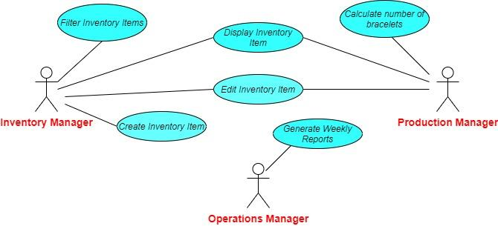
USE CASE DIAGRAM

Slide 7
USER AND SYSTEM REQUIREMENTS
03
Breakdown of the user requirements into system requirements

Slide 8
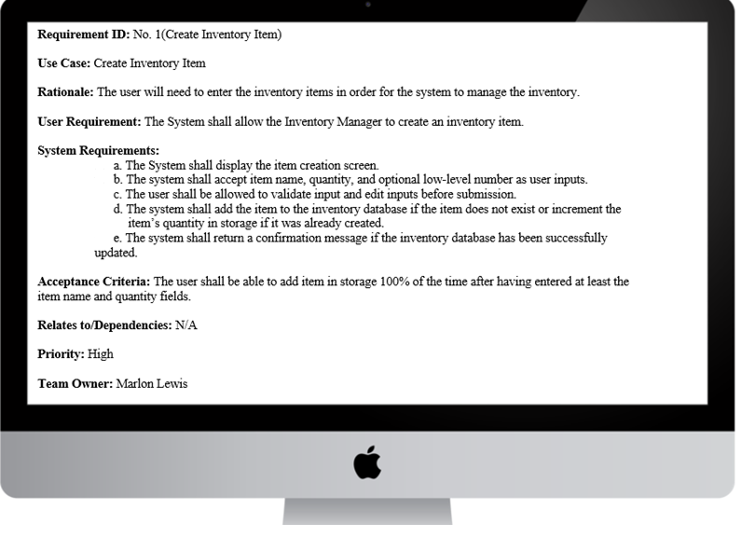

Slide 9
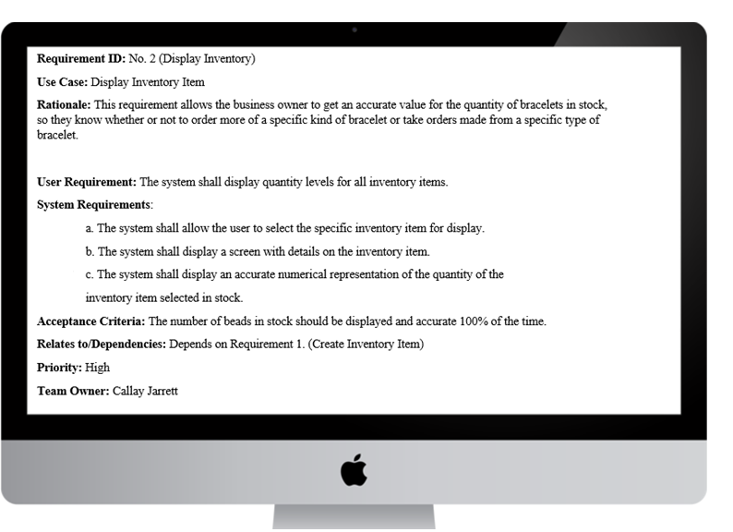

Slide 10
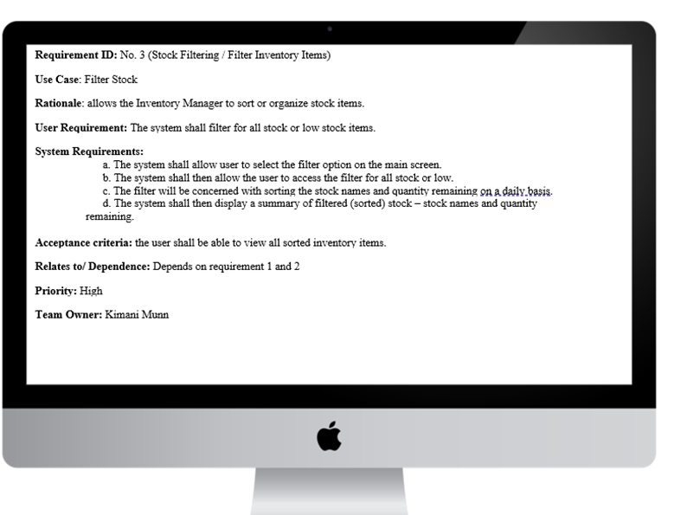

Slide 11
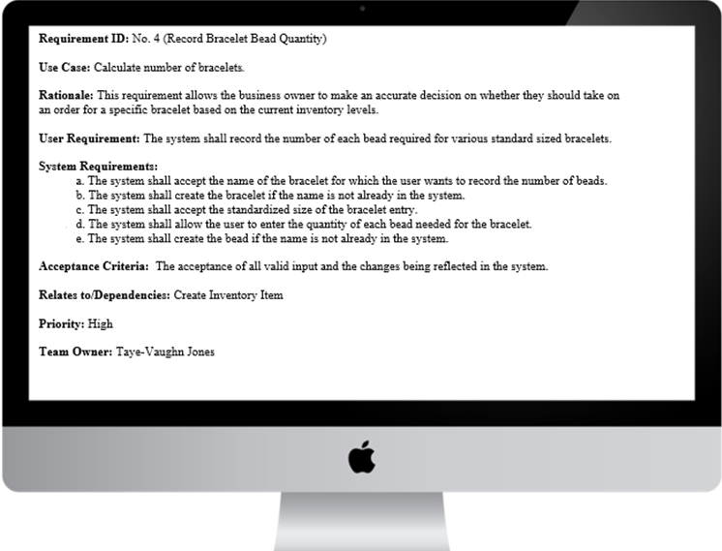

Slide 12
THANKS!
Any questions?
GROUP MEMBERS:
MARLON LEWIS
CALLAY JARRETT
GABRIEL SCOTT
MERCEDES SMITH
TAYE-VAUGHN JONES
KIMANI MUNN

